Slide 1



What Gets Unmasked First? Trajectory Analysis of Diffusion Models for Graph-to-Text Generation
Qing Wang, Jacob Devasier, Chengkai Li
The University of Texas at Arlington
EMNLP 2026 Findings
Budapest, Hungary
October 24th ～ 29th, 2026
Presented by: Qing Wang
Notes:
Hello, everyone. I’m Qing Wang from The University of Texas at Arlington.
Today, I’m going to present our work, “What Gets Unmasked First? Trajectory Analysis of Diffusion Models for Graph-to-Text Generation.”

Slide 2
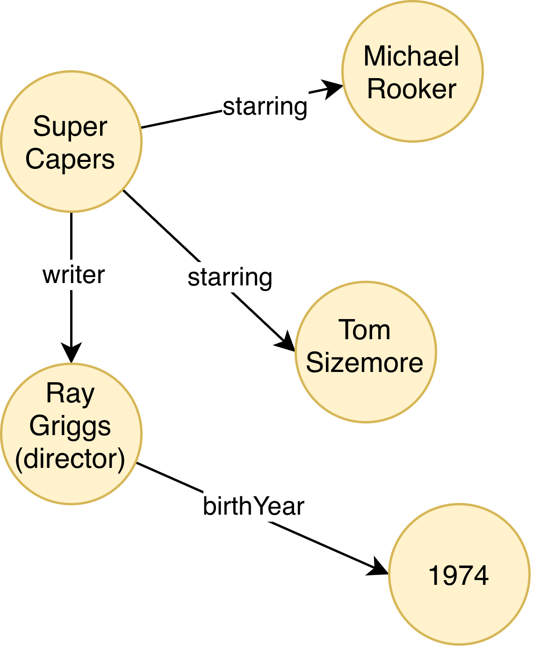
Graph-to-text Generation
It converts structured graph facts into natural-language descriptions.
Factual faithfulness is important.
Ray Griggs, who was born in 1974, is the director of the film `Super Capers'. He is also the writer of the film `Super Capers' which stars Tom Sizemore. The film 'Super Capers' stars Michael Rocker and Tom Sizemore.
Graph to Text Model
Hallucination
Super Capers stars Michael Goulding and Tomizemore.
Omission
Graph
Text
Notes:
In graph-to-text generation, the input is a graph including entities and relations, and the goal is to convert these structured facts into fluent natural-language descriptions.
A good model should express the information in the graph accurately.
However, two common problems are hallucination and omission.
Hallucination is The generated text contains entities, or relations that are not supported by the input graph.
Omission is The generated text fails to mention entities, or relations that are present in the input graph.
So factual faithfulness is particularly important for this task.

Slide 3
Motivation
Graph-to-text models are predominantly autoregressive.
Masked diffusion language models, though rarely explored for graph-to-text, may offer new opportunities to improve generation quality.
This study aims to investigate:
  How is structured graph information revealed during diffusion decoding?
  Can we reduce hallucinations and omissions by guiding the decoding trajectory?
Autoregressive large language models
Masked diffusion models (MDLMs)
The
The
[MASK]
[MASK]
[MASK]
[MASK]
[MASK]
[MASK]
The
neutral
The
[MASK]
[MASK]
[MASK]
[MASK]
policy
[MASK]
The
neutral
point
The
[MASK]
[MASK]
[MASK]
view
policy
[MASK]
The
neutral
point
of
The
neutral
[MASK]
[MASK]
view
policy
[MASK]
The
neutral
point
of
view
The
neutral
point
[MASK]
view
policy
[MASK]
The
neutral
point
of
view
policy
…
The
neutral
point
of
view
policy
…
E.g., LLaMA 3.1, LLaMA 3.3 , Qwen 3
E.g., LLaDA-8B, Dream-7B
Notes:
Graph-to-text generation has traditionally been approached with autoregressive models, but masked diffusion language models provide a different generation mechanism that may offer new opportunities for controlling factual generation.
Instead of committing to text strictly from left to right, diffusion models can revise and reveal different positions over multiple denoising steps.
So here, we compare two generation mechanism.
Because diffusion models are free to decide which positions to reveal first, they introduce an additional question:
In graph-to-text generation, which graph information is revealed first during diffusion decoding?

Slide 4
Trajectory Classification
Classify each token as entity, relation, stop word, punctuation, or other using a priority-based matching procedure.
Entity
Relation
Stop word
Punctuation
Hypermarcas
is
a
pharmaceutical
company
located
in
São
Paulo
,
Brazil
.
Notes:
To study this question, we use five categories:
entity, relation, stop word, punctuation, and other.
This allows us to separately track when different types of graph information appear during the generation process.

Slide 5
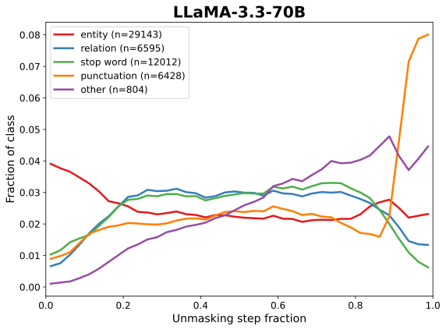
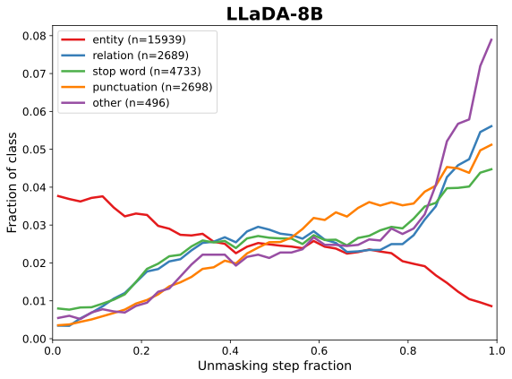
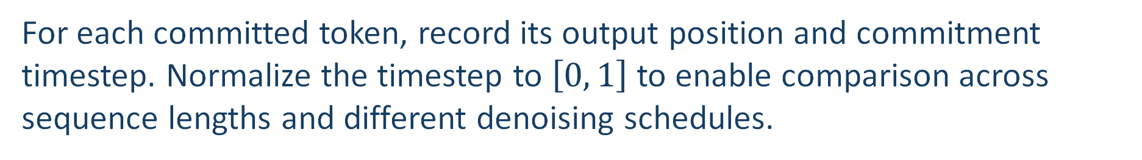
Trajectory Recording
For each committed token, record its output position and commitment timestep. Normalize the timestep to $\left[0 , 1\right]$ to enable comparison across sequence lengths and different denoising schedules.
MDLMs exhibit strong entity-first generation.
Notes:
Next, we record the commitment time of every generated token.
For each token, we record the denoising step at which the model commits to that token. We then aggregate these commitment times by token category.
The key observation is that masked diffusion models show a clear entity-first generation pattern. Entities tend to be committed early, and relations tend to appear later.

Slide 6
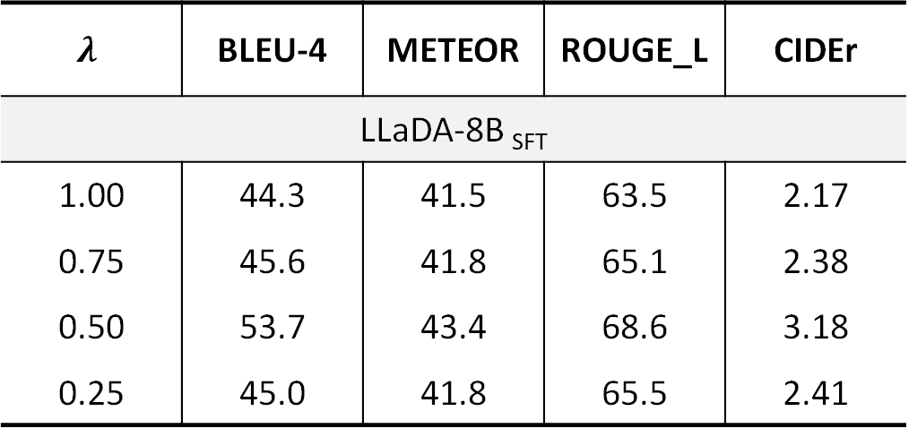
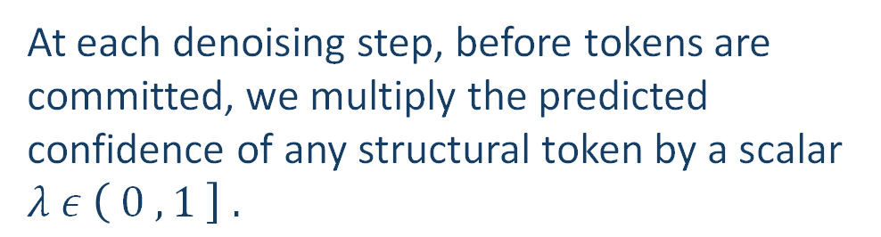
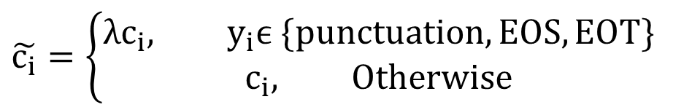
𝝀−𝐒𝐜𝐚𝐥𝐞𝐝 𝐒𝐭𝐫𝐮𝐜𝐭𝐮𝐫𝐚𝐥 𝐃𝐞𝐜𝐨𝐝𝐢𝐧𝐠
Matrix | LLaDA | LLaDA SFT
Content Before “.” | 60.9% | 17.8%
Mean First “.” | 0.652 | 0.144
Median First “.” | 0.835 | 0.062
Periods / Sample | 1.22 | 2.44
EOS / Sample | 37.2 | 21.4
$$λ$$ | BLEU-4 | METEOR | ROUGE_L | CIDEr
LLaDA-8B _{SFT}
1.00 | 44.3 | 41.5 | 63.5 | 2.17
0.75 | 45.6 | 41.8 | 65.1 | 2.38
0.50 | 53.7 | 43.4 | 68.6 | 3.18
0.25 | 45.0 | 41.8 | 65.5 | 2.41
$$\tilde{c_{i}}=\left\{\begin{aligned}λc_{i}, y_{i}ϵ \{punctuation, EOS,EOT\} \\ &c_{i}, Otherwise\end{aligned}\right.$$
At each denoising step, before tokens are committed, we multiply the predicted confidence of any structural token by a scalar $λ ε \left( 0 , 1 \right] .$
Scaling helps mitigate premature structural commitment from fine-tuned models and improve the quality of their generated text.
Notes:
However, we observe something interesting after supervised fine-tuning.
Before fine-tuning, LLaDA generates about 60.9 percent of its content before the first period. After supervised fine-tuning, this number drops to only 17.8 percent.
The model tends to commit to sentence structure too early, before enough semantic content has been established.
We refer to this behavior as premature structural commitment.
Once punctuation or sentence-ending tokens are committed too early, the remaining generation may become constrained, increasing the risk of missing graph information.
Based on this observation, we introduce the lambda-scaled structural decoding.
At each denoising step, before committing tokens, we reduce the confidence of structural tokens by multiplying their scores by a lambda between zero and one.
Non-structural tokens remain unchanged. And no additional training.
After applying λ-scaled decoding, BLEU 4 increases from 44.3 to 53.7.

Slide 7
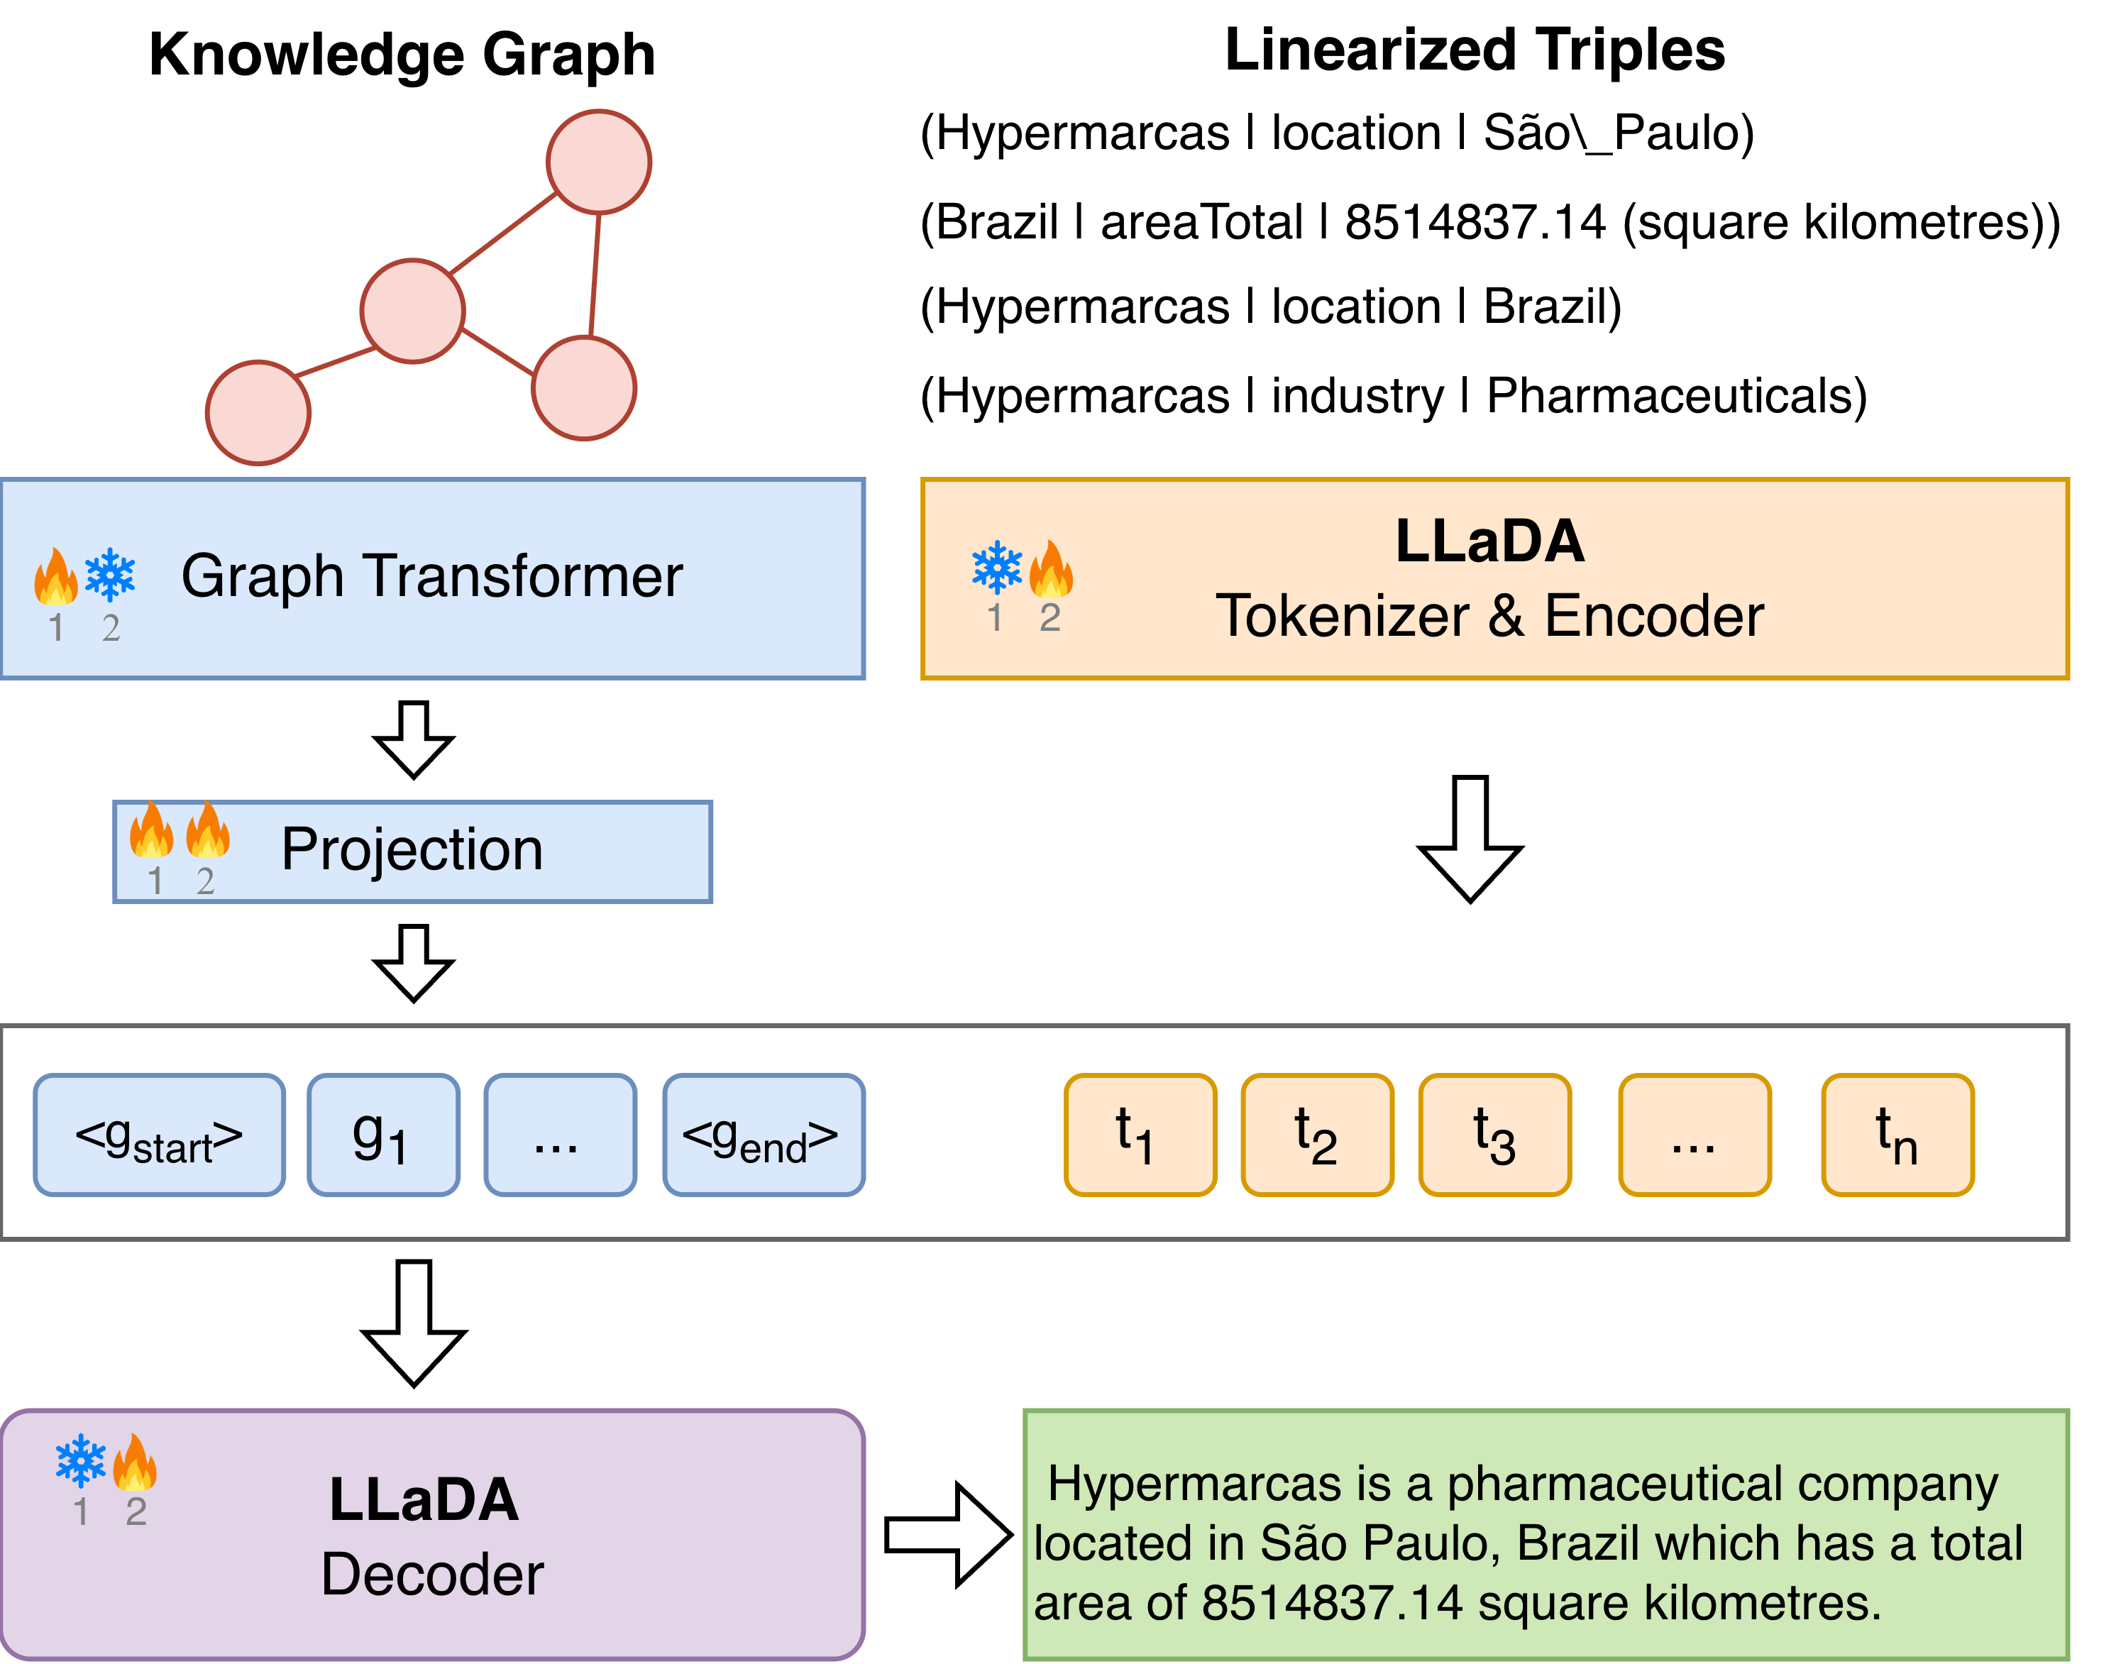


Graph-LLaDA Structure
We propose Graph-LLaDA, a graph-aware diffusion model designed to preserve graph structure during generation, improving graph-to-text quality and generalization.
Stage 1
Freeze LLaDA
Train Graph Transformer + Projector
Stage 2
Freeze Graph Transformer
  Train Projector + LoRA adapters
Notes:
We then ask another question:
Can we make the diffusion model use the graph structure itself more directly?
To address this, we propose Graph-LLaDA.
Graph-LLaDA is a graph-aware diffusion model that combines a Graph Transformer with LLaDA.
The Graph Transformer encodes the structured input graph,
and a projection module maps the graph representation into LLaDA’s embedding space.
Training is performed in two stages.
In Stage 1, we freeze LLaDA and train the Graph Transformer and the projector.
The goal is to align graph representations with LLaDA’s representation space.
In Stage 2, we freeze the Graph Transformer
and train the projector together with LoRA adapters in LLaDA.
The purpose of Graph-LLaDA is to incorporate graph structure into diffusion generation, rather than relying only on a serialized textual representation of the graph.

Slide 8
Evaluation Setup
Datasets
WebNLG: Human annotated benchmark dataset
LAGRANGE: Automatically constructed dataset
Models
Autoregressive LLMs: LLaMA 3.1, LLaMA 3.3, Qwen 3
Masked Diffusion Models: LLaDA-8B, Dream-7B, Graph-LLaDA
Supervised Graph-to-Text Models: GAP, JointGT and MGSA
Notes:
We evaluate these models on two graph-to-text datasets.
WebNLG is a human-annotated benchmark dataset, and LAGRANGE is an automatically constructed dataset.
We compare three groups of models: including, autoregressive LLMs , masked diffusion models and supervised graph-to-text models.

Slide 9
Evaluation Metrics
Automatic Evaluation
BLEU-4 / METEOR / ROUGE_L / CIDEr
Reference-based lexical overlap
Limited in capturing factual errors
Human Evaluation
50 WebNLG samples
2 human annotators
Fluency / Hallucination / Omission
LLMs Judge
1,000 pairwise comparisons
Two judges + reversed output order
Elo ratings for fluency / hallucination / omission
Notes:
For automatic evaluation, we use standard metrics.
These metrics are limited in capturing factual errors.
So we additionally conducted human evaluation and used LLM judges.

Slide 10
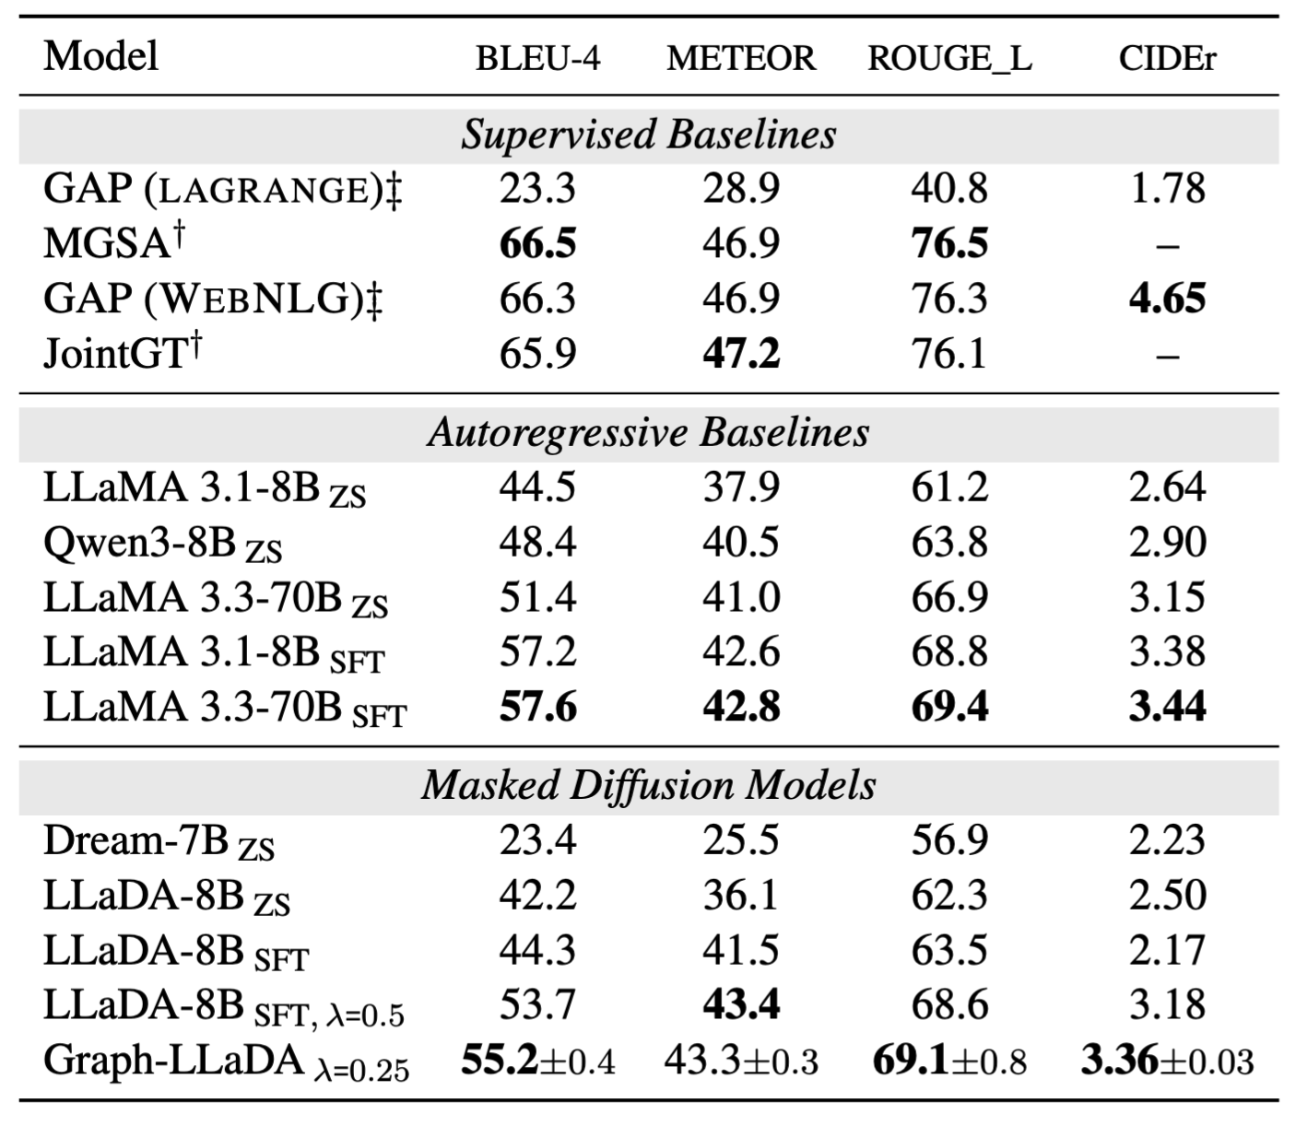
Model Performance
Supervised models perform best in-domain, but performance drops sharply when transferred across datasets.
Fine-tuning substantially improves both autoregressive and diffusion models.
Graph-LLaDA gives the strongest diffusion results.
out-of-domain
in-domain
Notes:
There are three important observations from the main results.
First, supervised graph-to-text models perform very strongly in-domain, but their performance drops substantially when transferred across datasets.
Second, supervised fine-tuning improves both autoregressive and diffusion models.
Third, among the diffusion models, Graph-LLaDA gives the strongest overall results.

Slide 11
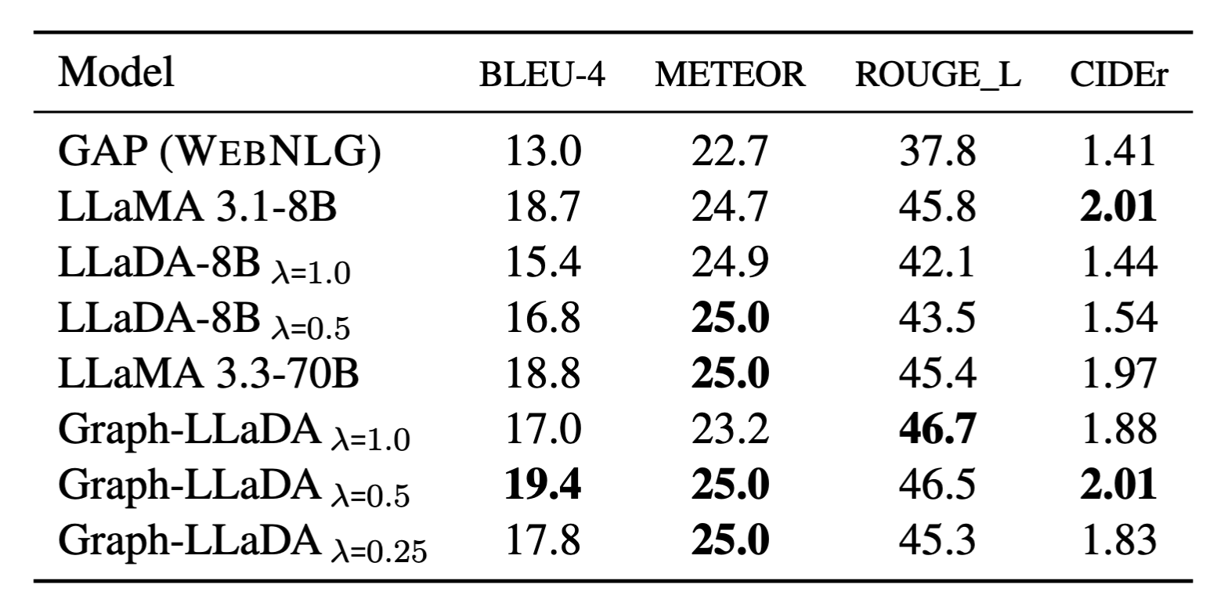
Cross-domain Performance
We evaluated cross-domain generalization by training the models on WebNLG and testing them on LAGRANGE.
Graph-LLaDA achieves the best overall cross-domain performance.
Notes:
We then evaluate cross-domain generalization by training the models on WebNLG and testing them on LAGRANGE. Here, Graph-LLaDA achieves the best overall cross-domain performance.

Slide 12
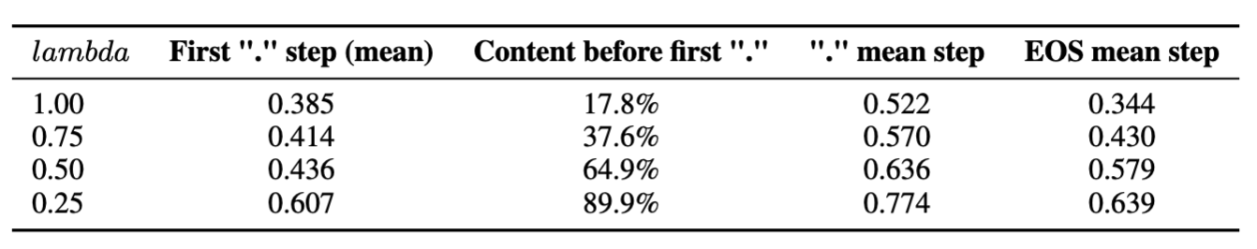
Effect of λ on Decoding Order
As λ decreases, more content is generated before sentence closure.
Smaller λ encourages the model to establish semantic content first, then finalize sentence structure.
Notes:
We also analyze how lambda affects the decoding trajectory.
As lambda becomes smaller, structural tokens such as punctuation and EOS are committed later.
So lambda is not simply changing the final evaluation score. It is directly changing how the model organizes generation over time.

Slide 13
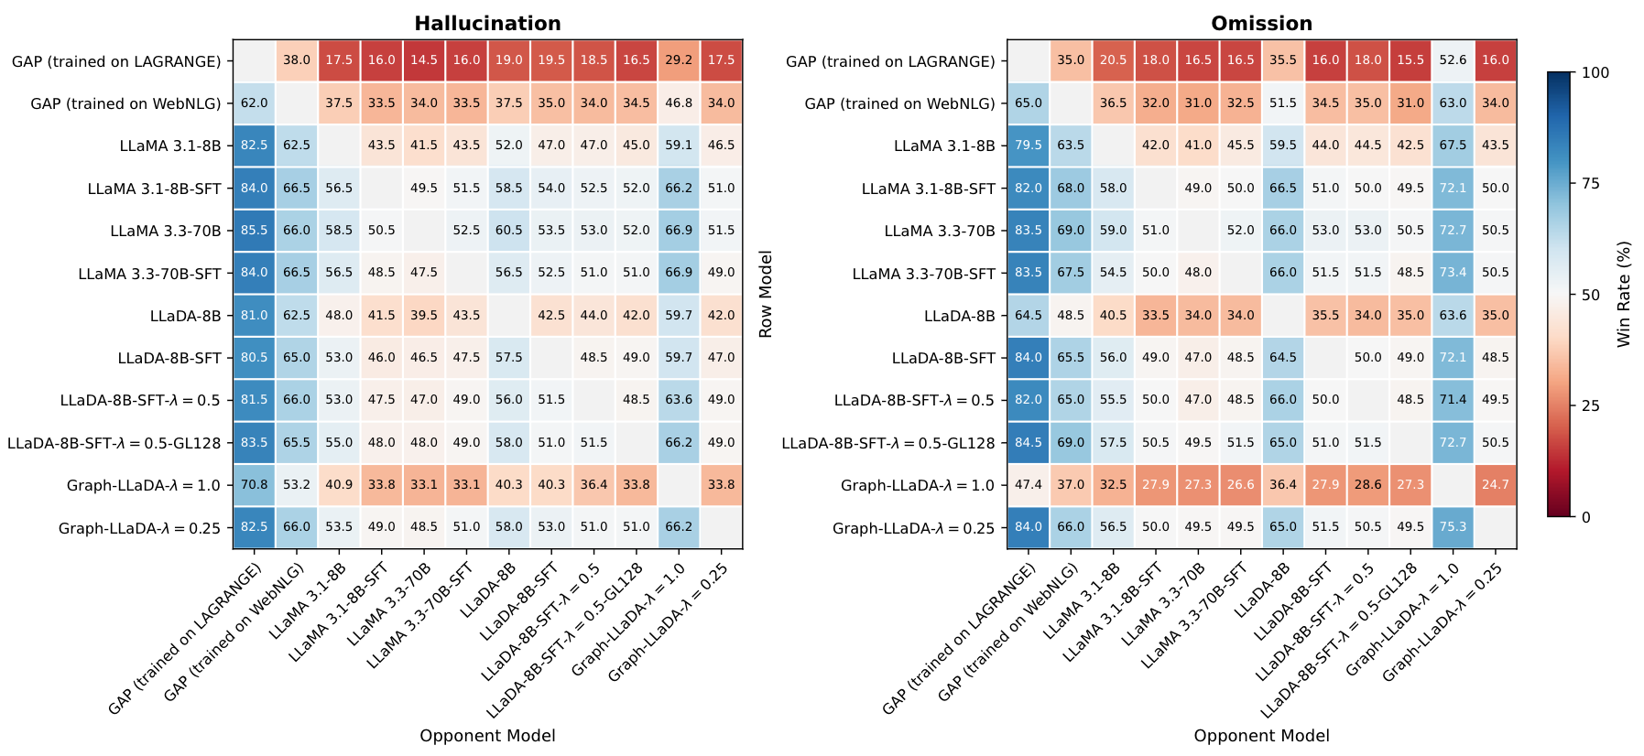
LLMs Judge
Pairwise Win Rates for Graph-to-Text Generation on WebNLG Using Qwen3.6 as Judge
Notes:
We compare pairwise win rates for fluency, hallucination, and omission.
One interesting observation is that supervised systems such as GAP perform well in fluency, but are generally weaker in terms of hallucination and omission.

Slide 14
Conclusions
We find that masked diffusion models naturally follow an entity-first generation trajectory.
We find that SFT causes premature structural commitment, which can lead to missing or hallucinated content; we therefore introduce λ-scaled decoding to delay structural tokens.
We propose Graph-LLaDA, which incorporates graph structure into diffusion decoding and improves both generation quality and cross-domain generalization.
Notes:
To conclude, I want to highlight three findings.
First, we find that masked diffusion language models naturally follow an entity-first generation trajectory.
Second, we find that supervised fine-tuning can disrupt this behavior and cause premature structural commitment. We introduce lambda-scaled structural decoding, a simple training-free approach that delays structural tokens and improves generation quality.
Third, we propose Graph-LLaDA, a graph-aware diffusion model that incorporates graph structure into the generation process. Graph-LLaDA improves both graph-to-text generation quality and cross-domain generalization.

Slide 15


Thank you!
https://github.com/idirlab/Graph_LLaDA
https://idir.uta.edu/
This work is supported by the National Science Foundation award # 2333834. The authors acknowledge the Texas Advanced Computing Center (TACC) for providing HPC resources.
Notes:
We thank the NSF for its support and TACC for providing computing resources.

